Slide 1
CSCI 130 PROJECT Team Camerota
By
Sarika Tandale
Sindhura Yalamanchali
Yasasvi Yeleswarapu
Leeladhar Reddy Munnangi

Slide 2
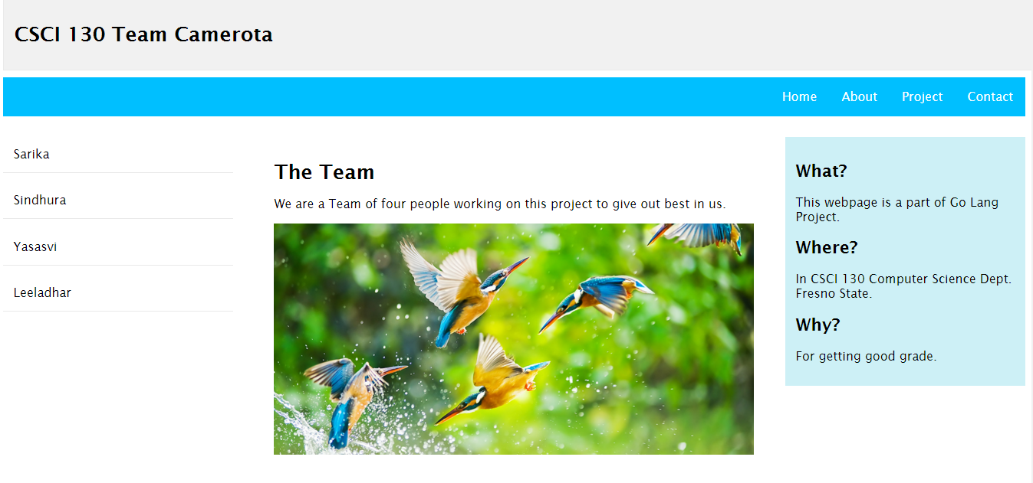
Webpage

Slide 3
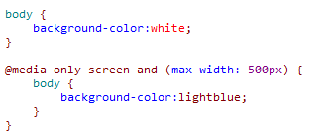
Media Query

Slide 4
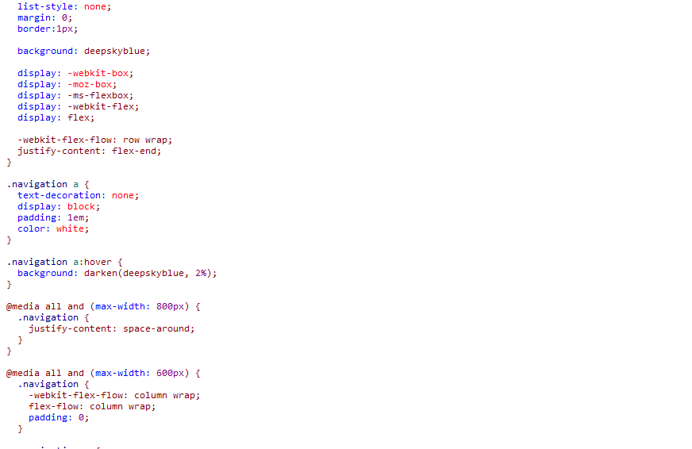
Flexbox

Slide 5
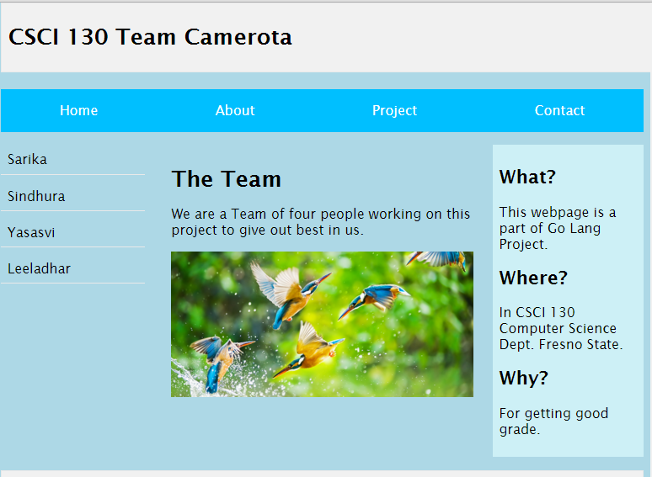
Effective Media Query &Flexbox

Slide 6
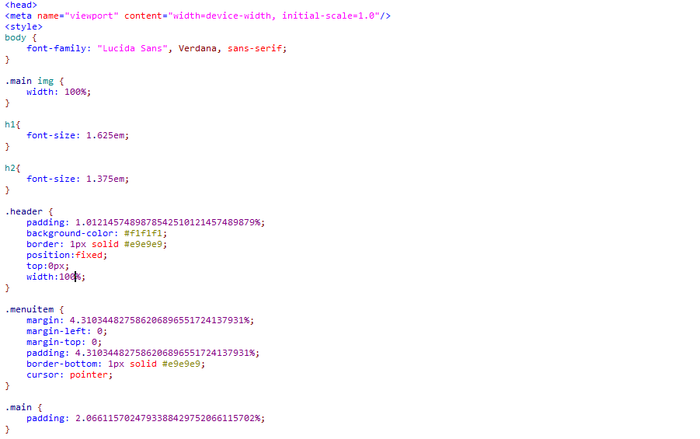
Above the “Fold”

Slide 7
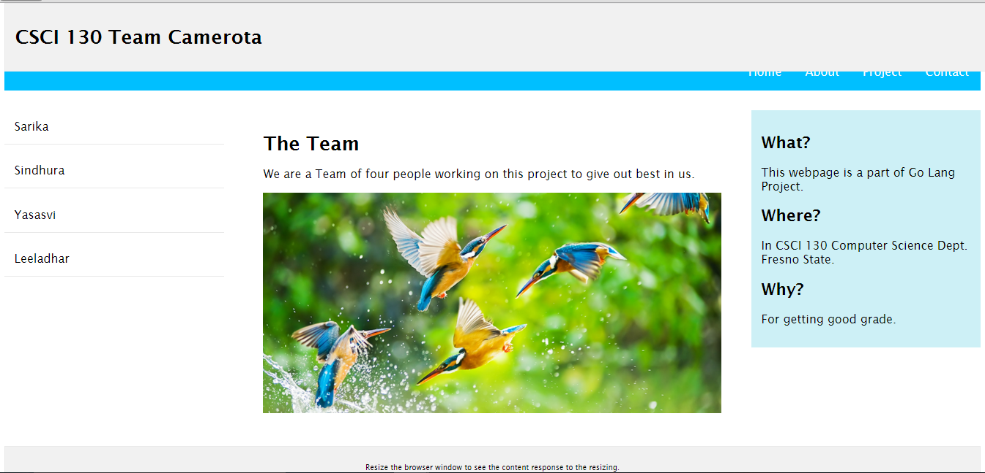
Above the Fold

Slide 8
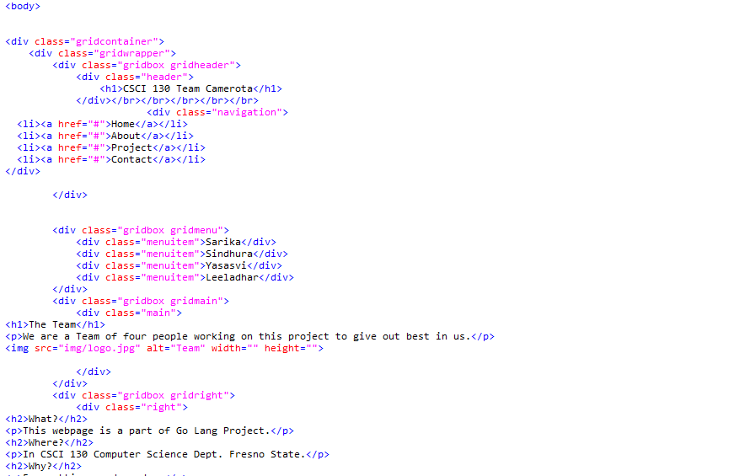
Webpage body

Slide 9
Thank you..!!
Suggestions please…!!

